Slide 1
MS4 Stormwater Presentation
By Lettice Brown
Ms4 Coordinator

Slide 2
Definitions
MS4 – Municipal Separate Storm Sewer System
Stormwater – Water from precipitation that flows across the ground and pavement when it rains or when snow and ice melt.
Storm Drains – where stormwater runs into, can be a basin or where it goes into underground pipes, Can be an enclosed pipe or an open channel.
Illicit Discharge – any discharge to a ms4 that is not composed entirely of storm water, except for allowable discharges pursuant to National Pollutant Discharge Elimination System (NPDES). (i.e. water from fire fighting activities)
Outfall – a discharge point of storm water into a body of water

Slide 3
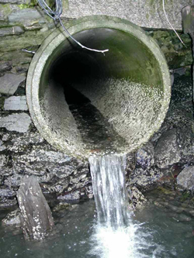
Difference between storm drain and sewer

Slide 4
Ms4 program
Ms4 permittees are required to incorporate the following (aka minimum control measures…mcm’s):
Public education and outreach
Public involvement and participation
Illicit discharge detection and elimination
Construction site runoff control
Post-construction stormwater management in new development and redevelopment
Pollution prevention and good housekeeping for municipal operations and maintenance

Slide 5
Authorized Discharges
Authorized: uncontaminated stormwater and non-stormwater discharges that are approved by npdes
Discharges from firefighting activities
Irrigation water
Diverted stream flows
Air conditioning condensation
Springs
Water from watering your lawn
Individual residential car washing
De chlorinated swimming pool discharges

Slide 6
Unauthorized discharges
Unauthorized:
Discharges that are mixed with sources of non-stormwater unless that discharge is in compliance with the npDes permit
Stormwater discharges from industrial activity that leads to contamination
Stormwater discharges from construction activity that leads to contamination
Stormwater discharges from food activity that leads to contamination
Discharges that contain hazardous pollutants or toxins
Discharges that are not, or shall not be, in compliance with the terms and conditions of the general permit

Slide 7
What is in our ms4 area?
Codorus creek – from bantz park to behind smalls field
Tyler run – from the colonial shopping center on s. George street to the codorus creek near kings mill road
Mill creek – a small square area between eberts lane, Wallace street, north east street and the railroad tracks
Poorhouse run – Just behind the old Weis on Edgar Street, through veterans Memorial Park to Hannah Penn, goes underground to Goode School
Hokes mill run – has one outfall in our boundary at the far end of bantz park near s. richland ave
Willis run – A few outfalls in the industrial park off of Pennsylvania avenue. Starts around the apple auto park near Kenneth road, travels to Roosevelt avenue, through Lincoln park, the football field and Kiwanis lake, then ends near east 2nd Avenue, near the intersection of north George street and parkway boulevard
Lighteners run – 3 outfalls near Pennsylvania avenue and vogelsong drive

Slide 8
York city boundary with outfalls

Slide 9
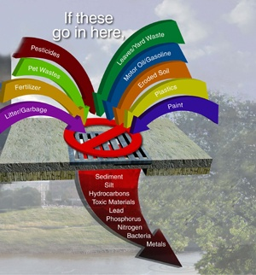
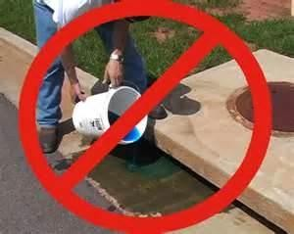
DO Not dump!!!

Slide 10
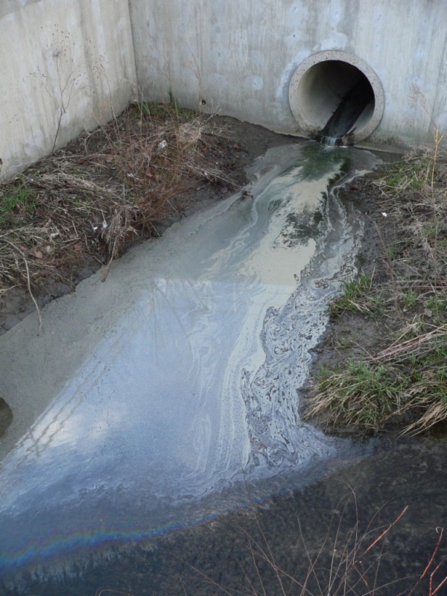
Illicit Discharge Examples

Slide 11
Illicit Discharges Continued

Slide 12
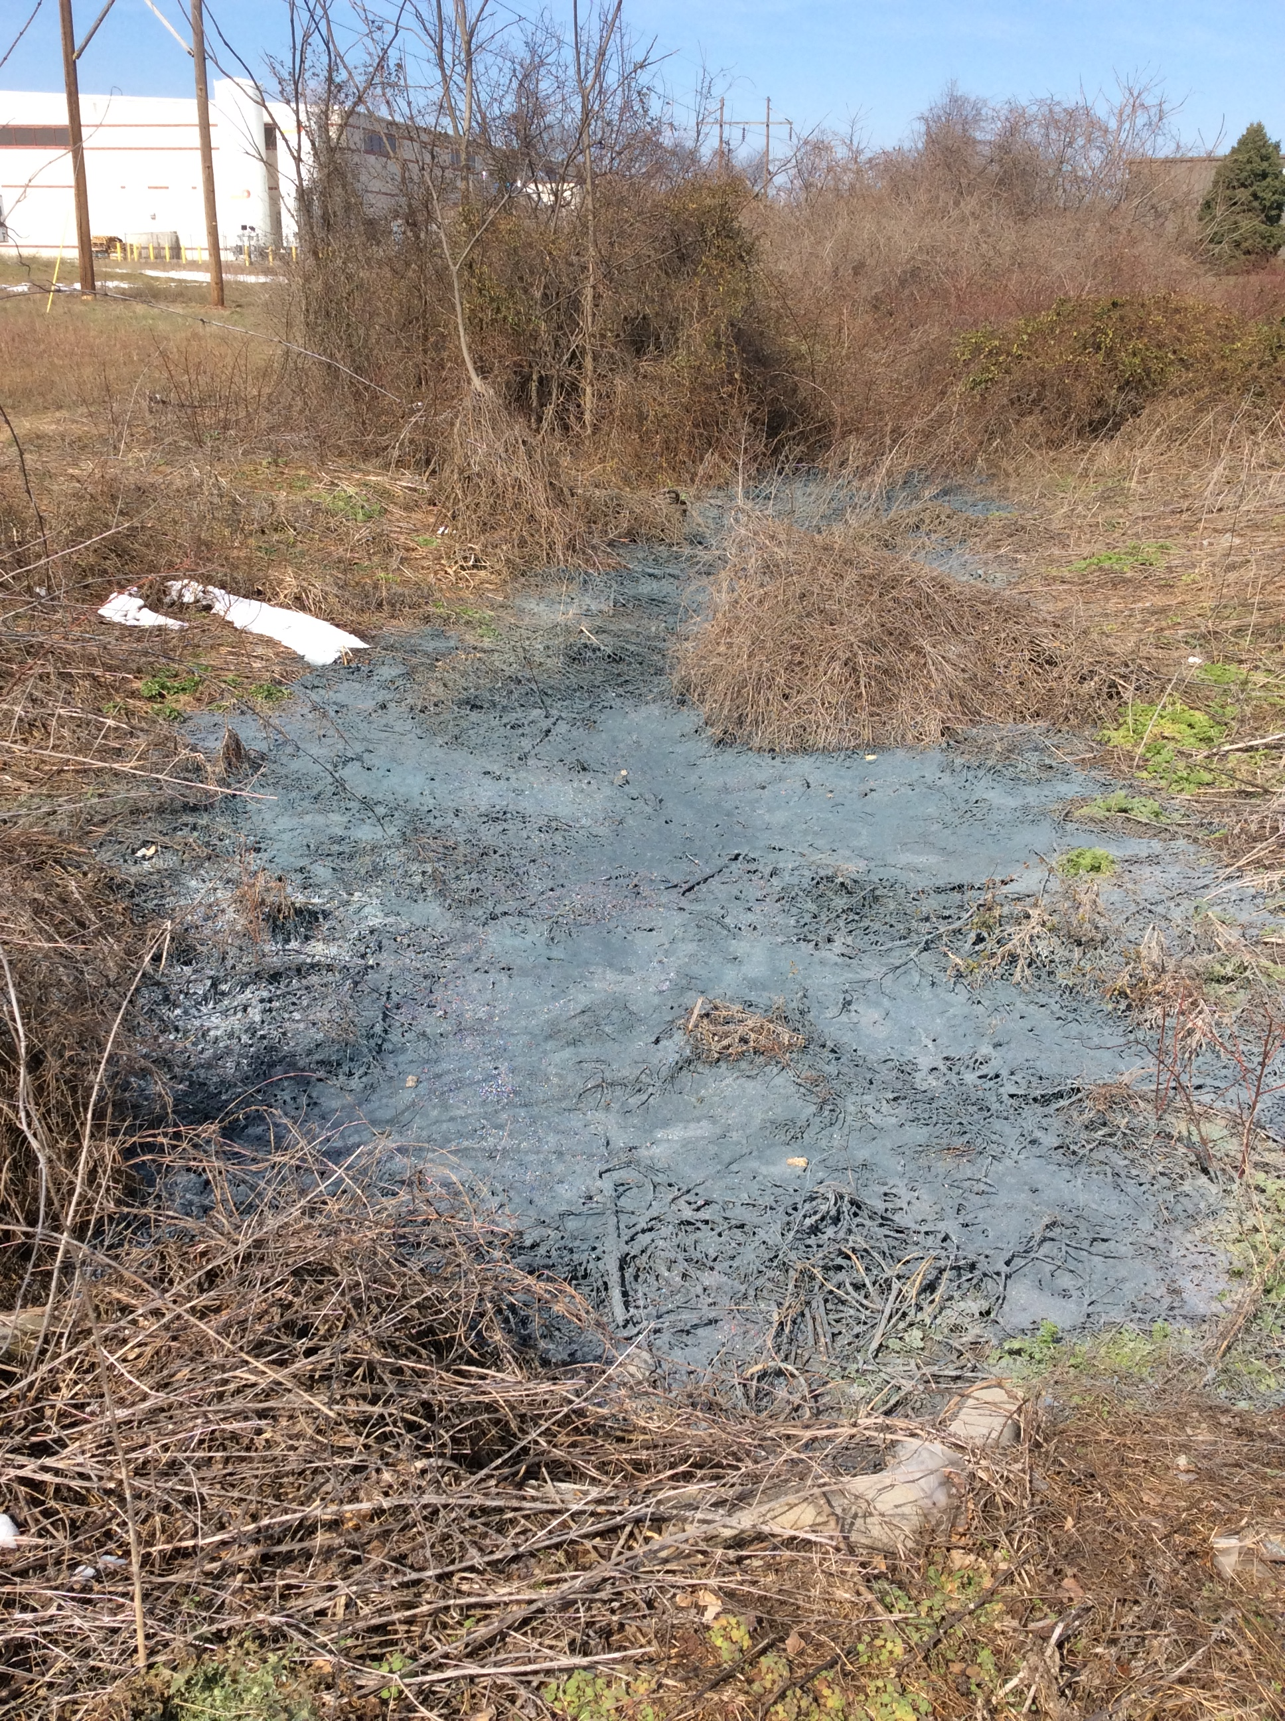
Illicit Discharges Continued

Slide 13
Illicit Discharges Continued

Slide 14
Illicit discharge examples continued

Slide 15
MS4 Accomplishments – First 7 months
MS4 Coordinator position was created last year and I was hired on October 31st 2016.
Achievements since then include:
Various education materials handed out to residents – door to door on foot
Booth at the Go Green event in april
Booth with materials at the olde York street fair
Coordinated with kyb with a willis run clean up on may 20th
Numerous investigations of illicit discharges

Slide 16
MS4 accomplishments continued
Trained all city employees on ms4 material, including police and fire in first 90 days
Visited three classes at Ferguson, educating children about litter, Recycling and stormwater
Attended many multi-municipal meetings on various ms4 topics
MS4 Task Force, Ms4 Maintenance committee, York County Stormwater Consortium-Regional committee meetings, Chesapeake bay pollution reduction plan (cbprp) meetings, stormwater conferences and In june I will test to be a certified stormwater inspector
Completed inspections of poorhouse run/mill creek, willis run/lighteners run, and about 2/3 of codorus creek outfalls – about 180. about 350 outfalls total
All priority outfalls inspected for the 2017-2018 permit year – 9 outfalls

Slide 17
Who to contact?
Ms4 Coordinator – Lettice Brown – 717-324-6532
Email: lbrown@yorkcity.org
Dep emergency line – 866-825-0208

Slide 18
Questions?

